Slide 1
CIS 700-004: Lecture 5M
CNNs and Capsule Nets
02/10/19
Notes:
Done

Slide 2
Course Announcements
HW0 has been graded -- please post on Piazza for regrade requests.
HW1 has been released, due 2/22. Start early!

Slide 3
Today's Agenda
Brief look at HW1
A convolution exercise
CNNs in PyTorch
CNN architectures
Applications of CNNs
Questioning translational invariance: the motivation for capsule nets

Slide 4
A convolution exercise
Notes:
Done

Slide 5
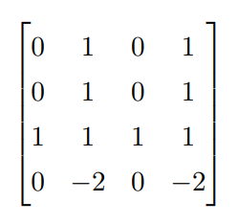
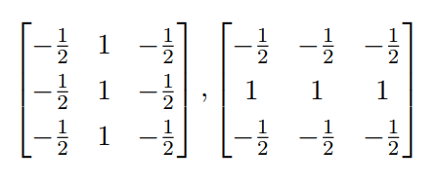
A convolution exercise
Suppose we want to find out whether the following image depicts Cartesian axes.
We do so by convolving the image with two filters (no padding, stride of 1) and applying a max-pool operation with kernel width of 2.
Compute the output by hand.

Slide 6
A convolution exercise

Slide 7
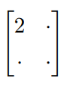
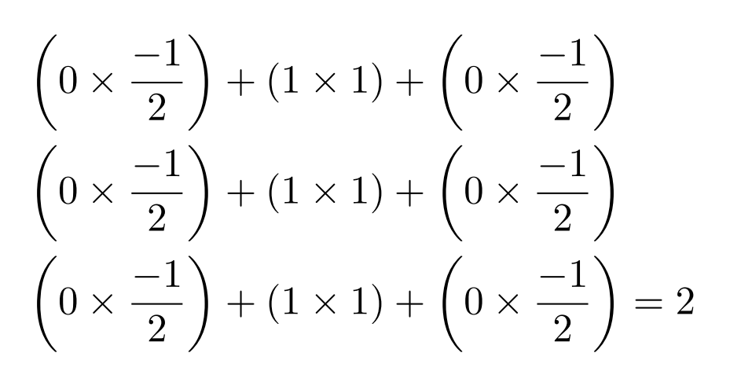
A convolution exercise

Slide 8
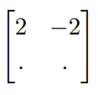
A convolution exercise

Slide 9
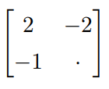
A convolution exercise

Slide 10
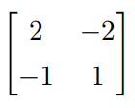
A convolution exercise

Slide 11
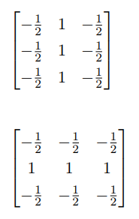
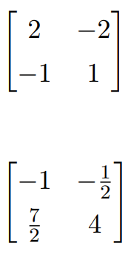
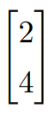
Convolution exercise solution
Grayscale image
Filters
Output of filters
Output of max-pool

Slide 12

CNNs are translation-invariant by design.
Although we would like many other kinds of invariance, none are baked into the architecture of CNNs.

Slide 13
CNNs in PyTorch
Notes:
Done

Slide 14
Let's design a CNN.
MNIST images have size 28x28x1 (black-and-white images have 1 feature / pixel)
Design 2 conv. layers that reduce images to 7x7 and create 32 features. Specify your filter size, stride, and pooling kernel size.
Finish classifying using a feedforward net. There are 10 labels.

Slide 15
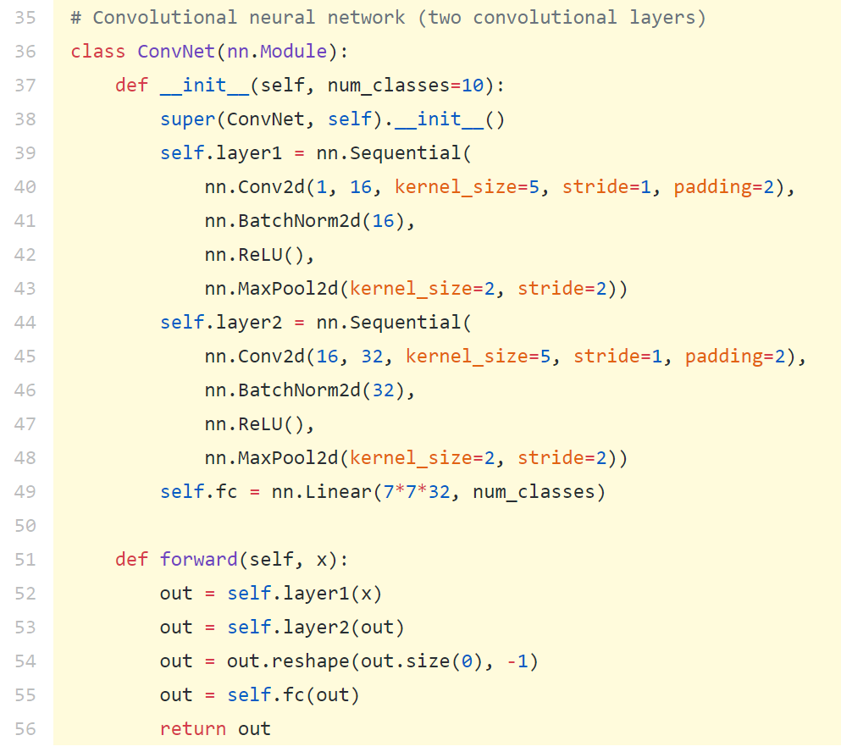
Now let's build it in PyTorch.
https://pytorch.org/docs/stable/nn.html#convolution-functions
Notes:
https://pytorch.org/docs/stable/nn.html#convolution-functions

Slide 16
Some classic CNNs
Notes:
Done

Slide 17
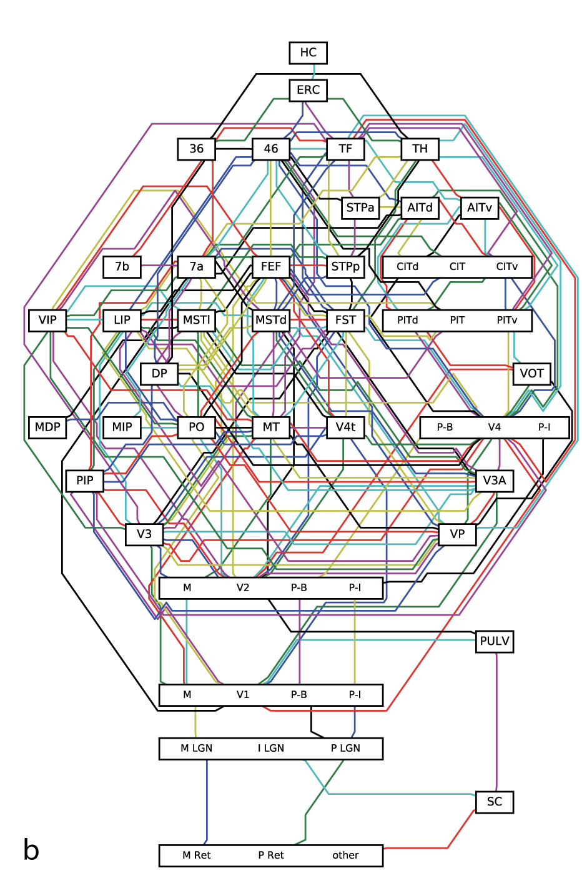
Architectures as inductive biases

Slide 18
CNNs perform extremely well on CV datasets.

Slide 19
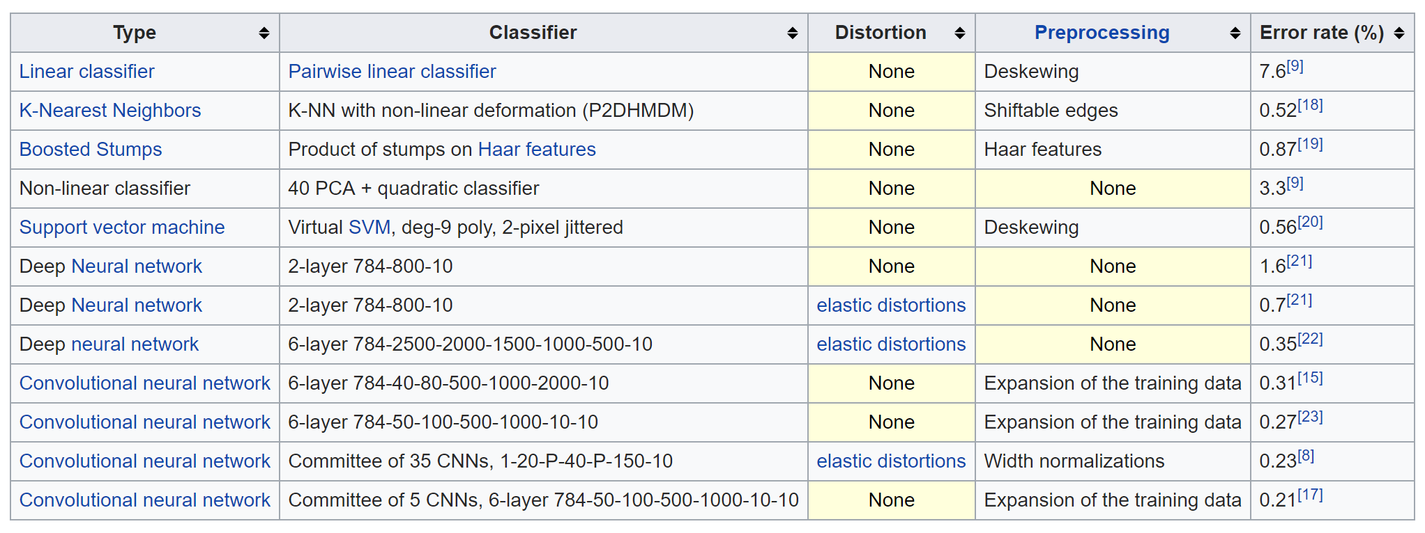
CNNs perform extremely well on MNIST.

Slide 20
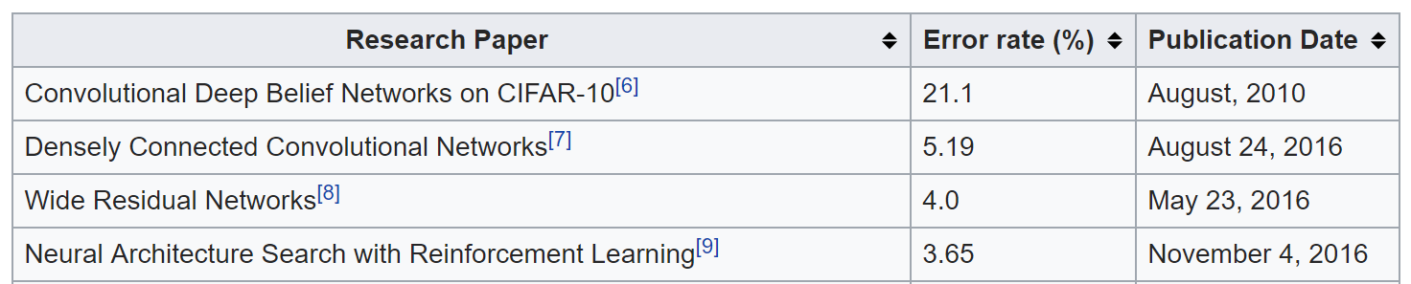
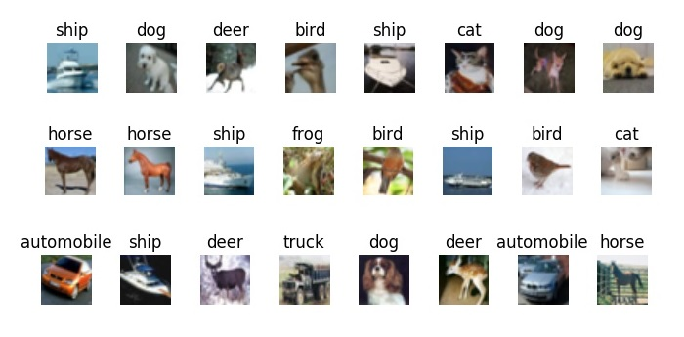
CNNs perform reasonably well on CIFAR-10
Feedforward neural nets achieve about 50% accuracy.

Slide 21
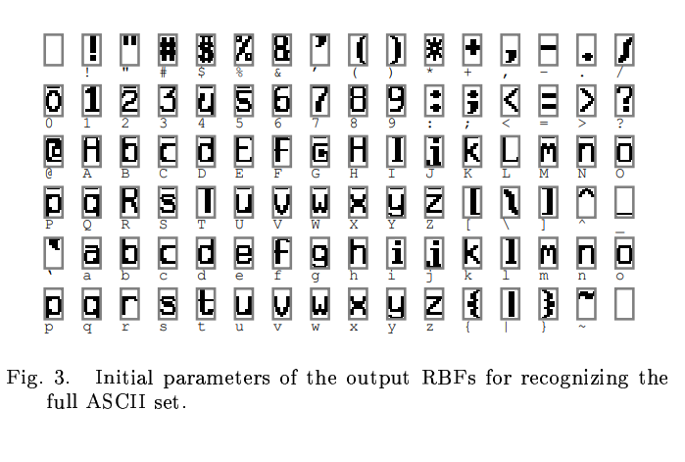
LeNet (1998) -- Background
Developed by Yann LeCun
Worked as a postdoc at Geoffrey Hinton's lab
Chief AI scientist at Facebook AI Research
Wrote a whitepaper discovering backprop.
Co-founded ICLR
Problem: classify 7x12 bit images of 80 classes of handwritten characters.

Slide 22
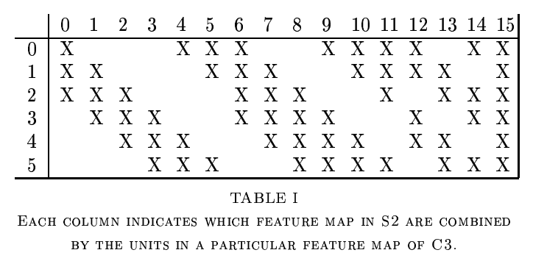
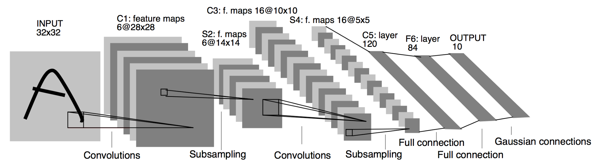
LeNet (1998) -- Architecture
Convolution filter size: 5x5.
Subsampling (pooling) kernel size: 2x2.
Semi-sparse connections.

Slide 23
LeNet (1998) -- Results
Successfully trained a 60K parameter neural network without GPU acceleration!
Solved handwriting for banks -- pioneered automated check-reading.
0.8% error on MNIST; near state-of-the-art at the time.
Virtual SVM, kernelized by degree 9 polynomials, also achieves 0.8% error.
LeNet: http://yann.lecun.com/exdb/publis/pdf/lecun-01a.pdf
SVM: http://yann.lecun.com/exdb/publis/index.html#lecun-98

Slide 24
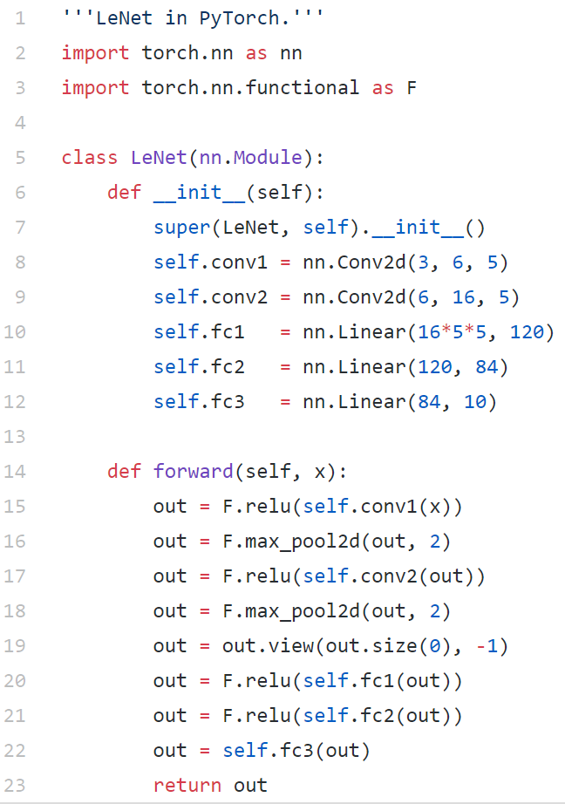
LeNet in PyTorch

Slide 25
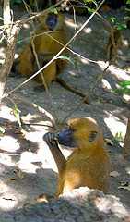
AlexNet (2012) -- Background
Developed by
Alex Krizhevsky
Ilya Sutskever
Chief scientist, OpenAI
Inventor of seq2seq learning.
Geoffrey Hinton, Alex Krizhevsky's PhD adviser
Co-invented Boltzmann machines
Problem: compete on ImageNet, Fei-Fei Li's dataset of 14 million images with more than 20,000 categories (e.g. strawberry, balloon).

Slide 26
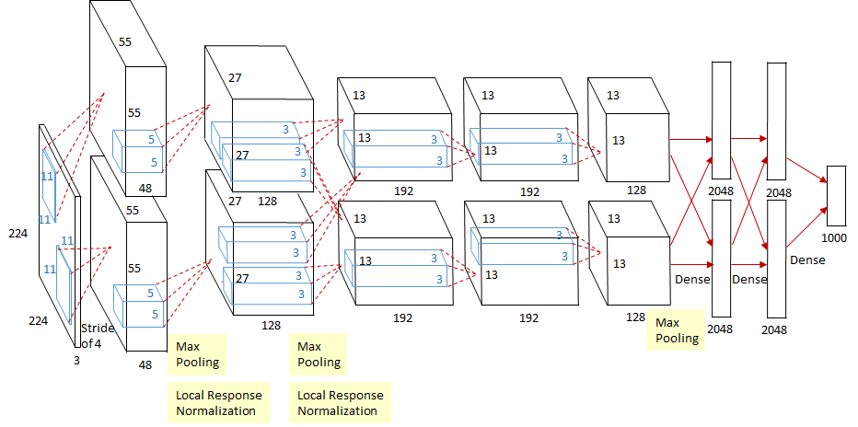
AlexNet (2012) -- Architecture
Input of 224x224x3 images.
8 weighted layers
5 convolutional layers.
Filter width 11, then 5, then 3
Stride 4
A lot of max-pooling layers
Kernel width 3
Stride 2
3 fully connected layers.
ReLU activation until last layer (which was softmax)
Trained with dropout and local response normalization

Slide 27
AlexNet (2012) -- Results
Smoked the competition with 15.3% top-5 error (runner-up had 26.2%)
One of the first neural nets trained on a GPU with CUDA.
(There had been 4 previous contest-winning CNNs)
Trained 60 million parameters
Cited over 30,000 times: https://papers.nips.cc/paper/4824-imagenet-classification-with-deep-convolutional-neural-networks.pdf

Slide 28
AlexNet in PyTorch
import torchvision.models as models
alexnet = models.alexnet()

Slide 29
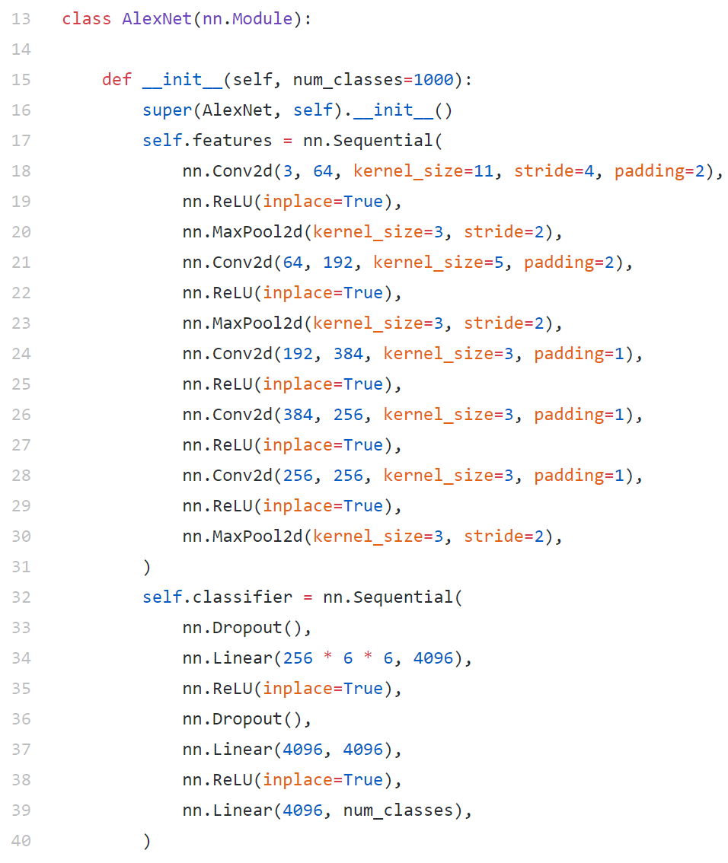
AlexNet in PyTorch (source code)
Notes:
27 lines

Slide 30
VGG (2014) -- Background
Developed by the Visual Geometry Group (Oxford)
Problem: beat AlexNet on ImageNet

Slide 31
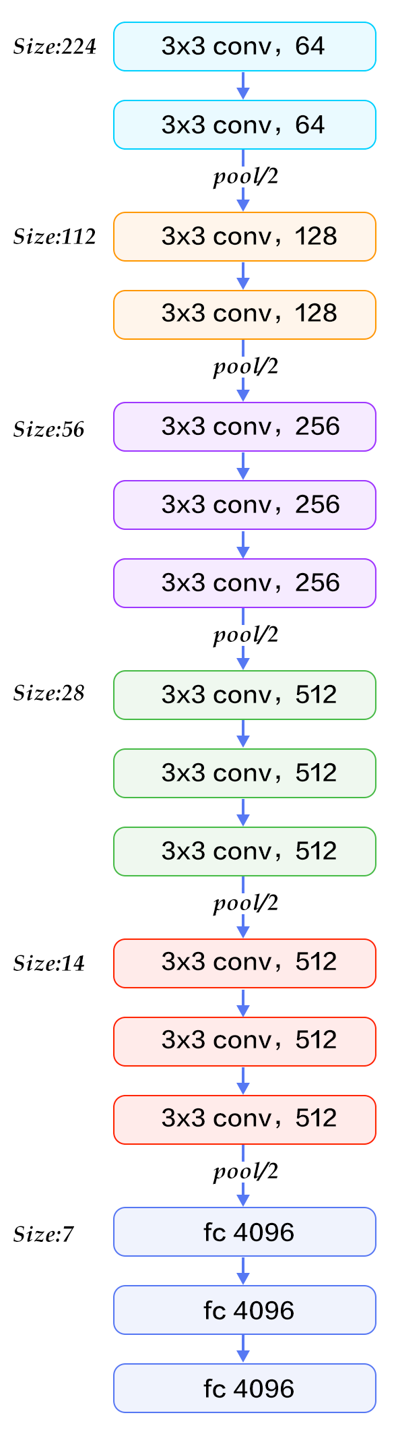
VGG (2014) -- Architecture
The deepest neural net ever.
138 million parameters

Slide 32
VGG (2014) -- Results
Configuration E (19 weighted layers) achieved 8.0% top-5 error.
https://arxiv.org/pdf/1409.1556.pdf

Slide 33
VGG in PyTorch
import torchvision.models as models
vgg16 = models.vgg16()
No useful source code to speak of; the neural net is so prohibitively large (hence, a pain to train) that the model features are downloaded.

Slide 34
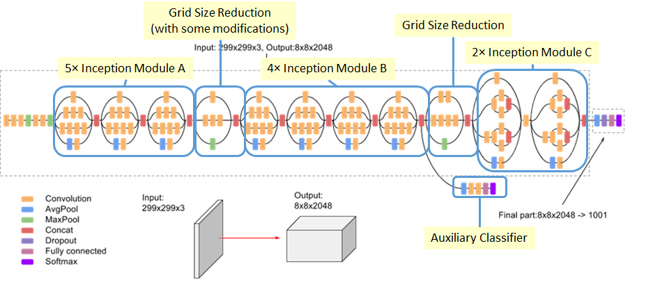
Inception / GoogleNet (2015)
Notes:
Done

Slide 35
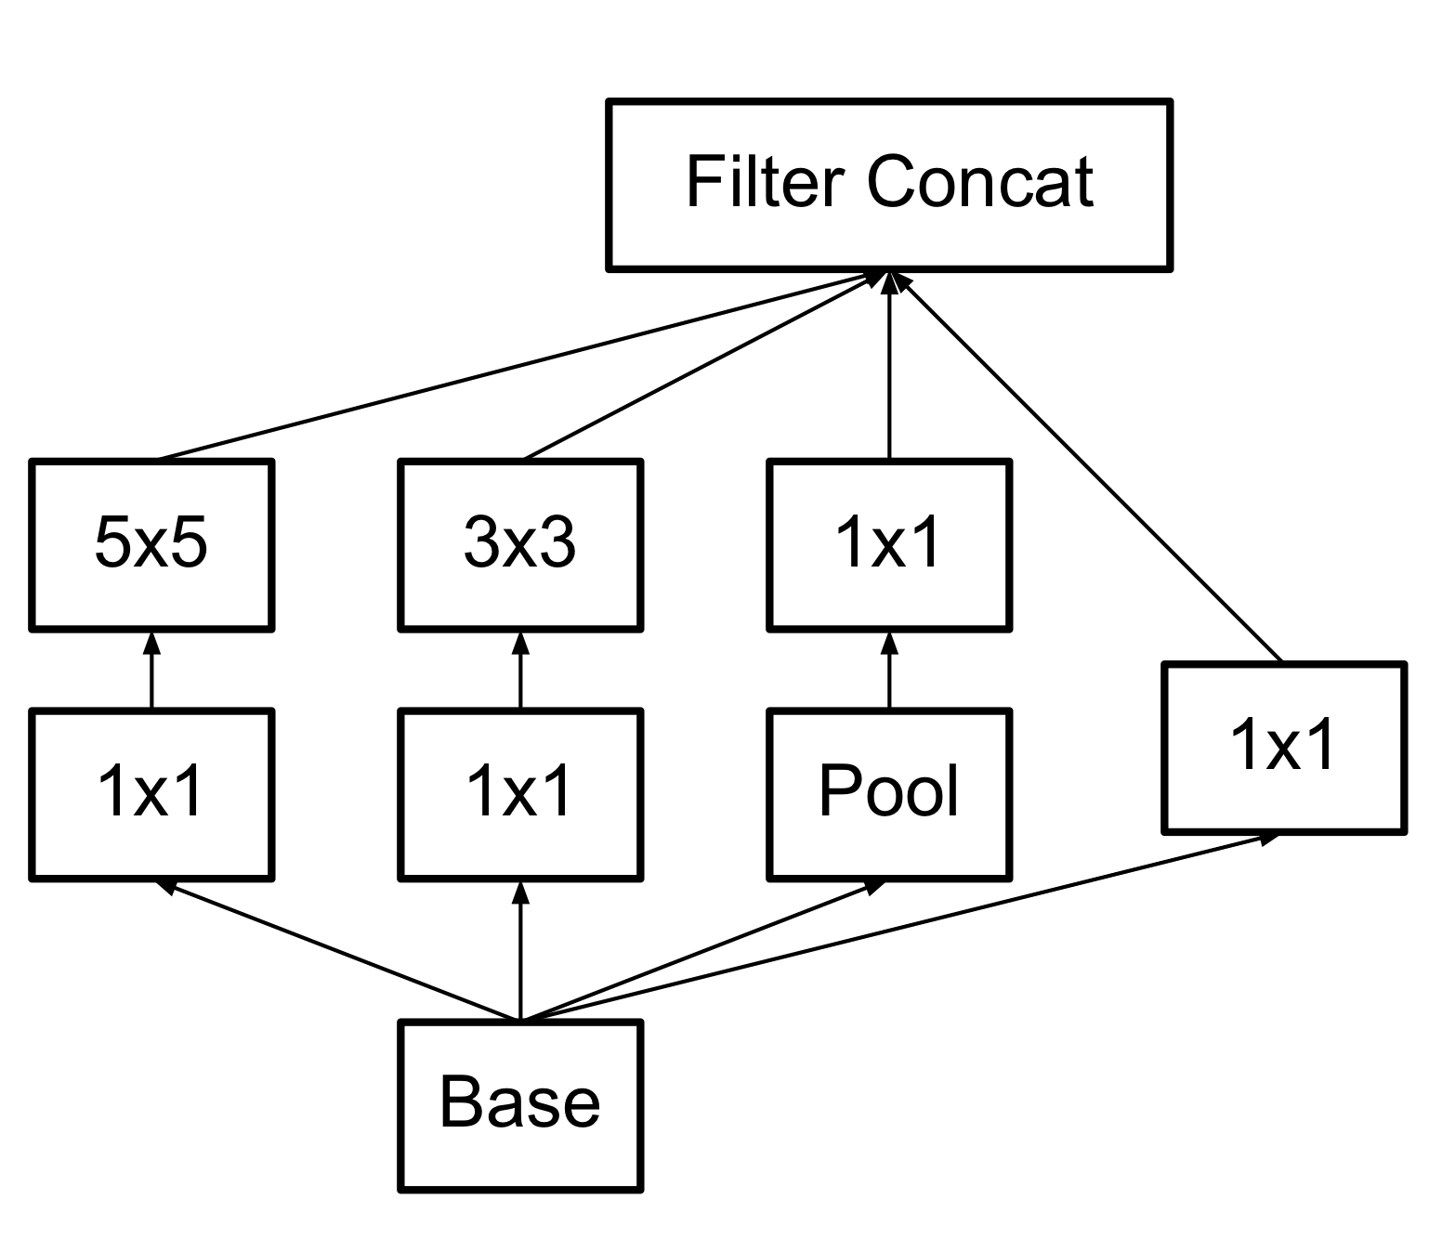
Inception v1: tuning kernel size is hard.
A computer scientist's solution: toss 'em all together.
A single "Inception Module"
Notes:
Done

Slide 36
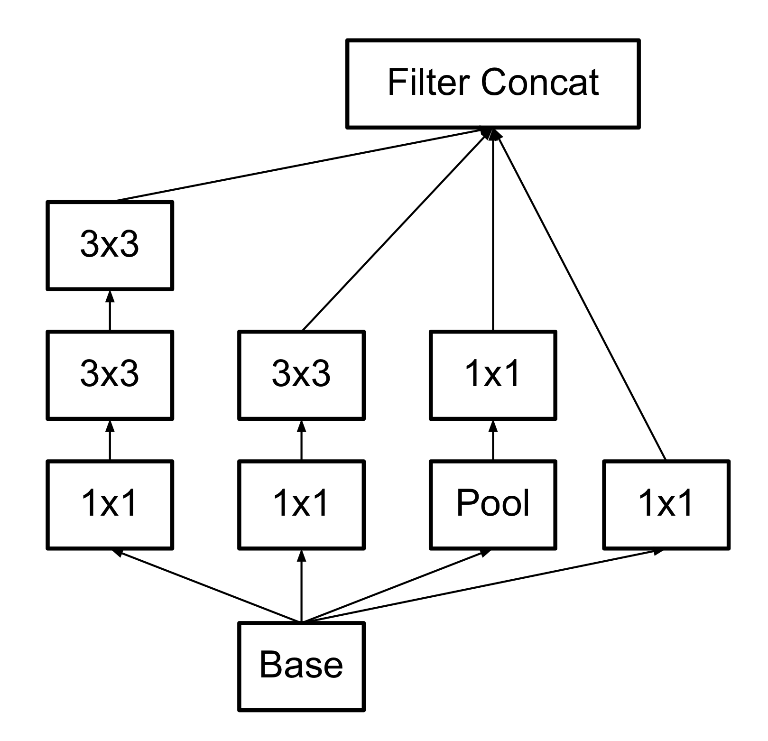
Inception v3: compute, representational bottlenecks
Original
Later version
Representational bottleneck: worse learning properties when the dimensions of the data are drastically changed all at once (more on that next week).
Notes:
Do the picture on the board

Slide 37
Inception (2014) -- Results
6.67% top-5 error rate!
Andrej Karpathy achieved 5.1% top-5 error rate.

Slide 38
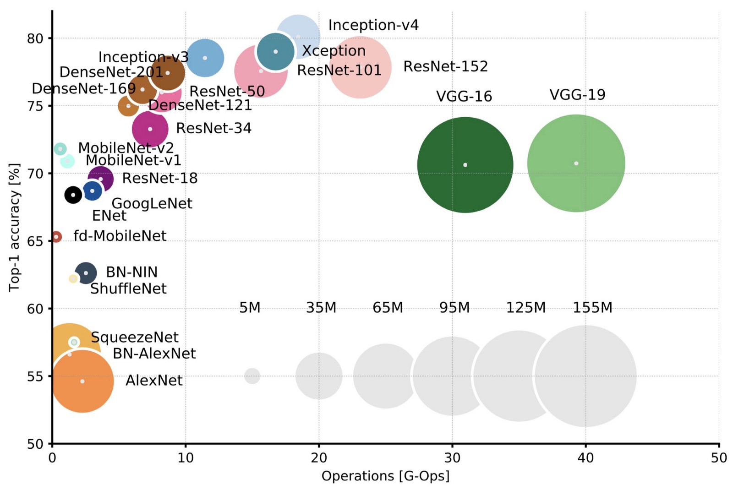
Performance of convolutional architectures on ImageNet
Notes:
https://arxiv.org/pdf/1605.07678.pdf

Slide 39
Applications of CNNs
Notes:
Done

Slide 40
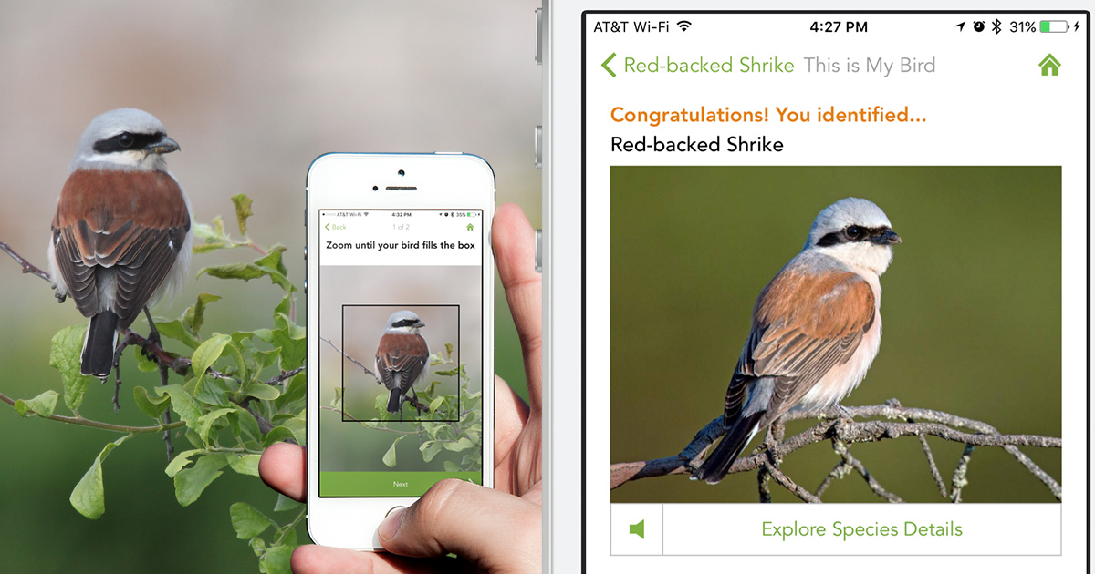
Image recognition
Cornell Lab of Ornithology, Merlin bird identification app (see Van Horn et al. 2015)
Notes:
Done

Slide 41
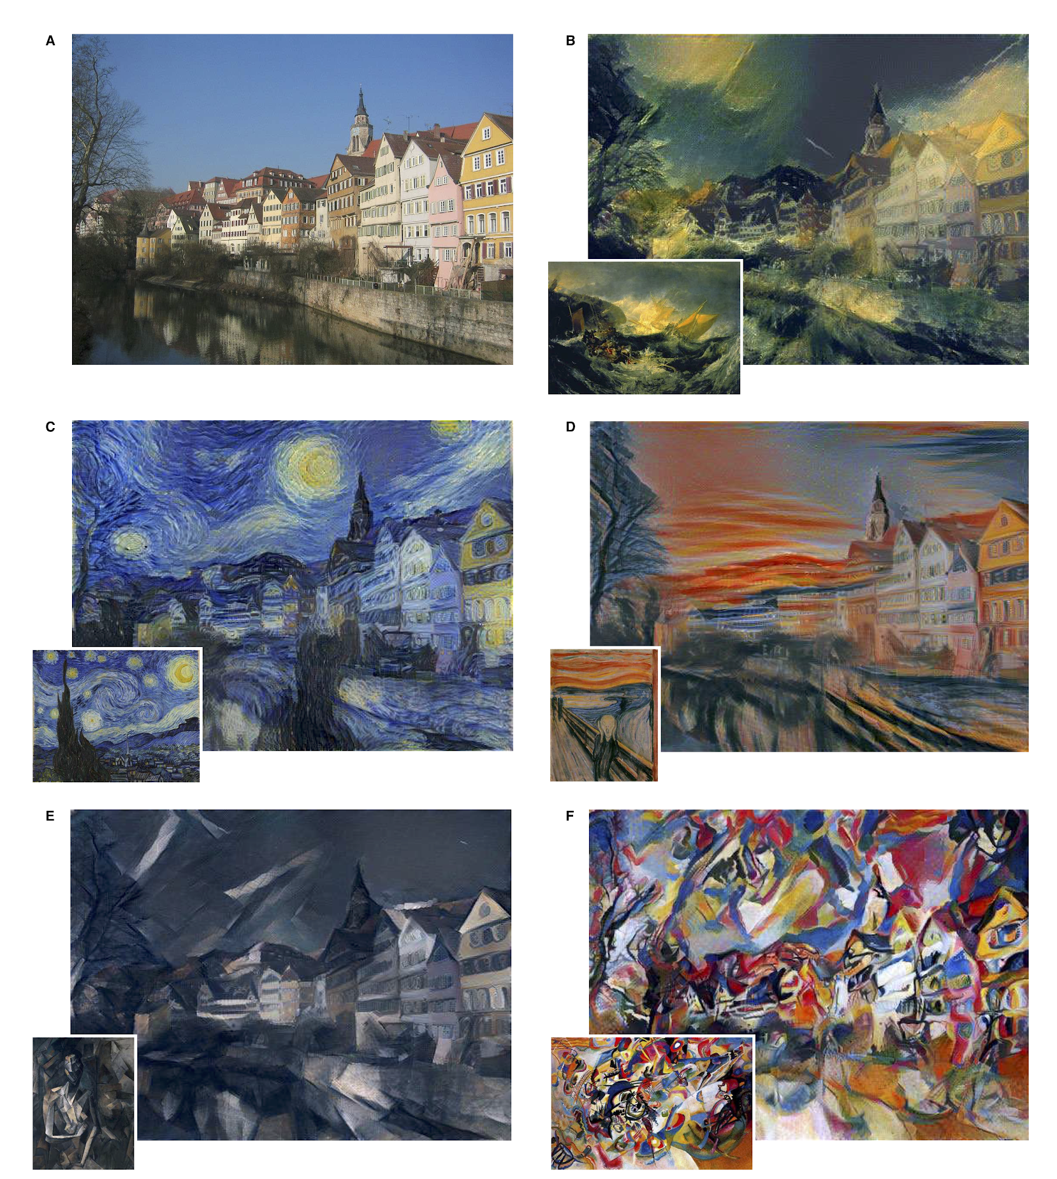
Style transfer
Gatys et al. (2016)
Content is measured by deeper layers.
Style is measured by the correlations between feature vectors at lower layers.
Objective 1: Minimize content difference between new image and content template.
Objective 2: Minimize style difference between new image and style template.
Notes:
Done

Slide 42

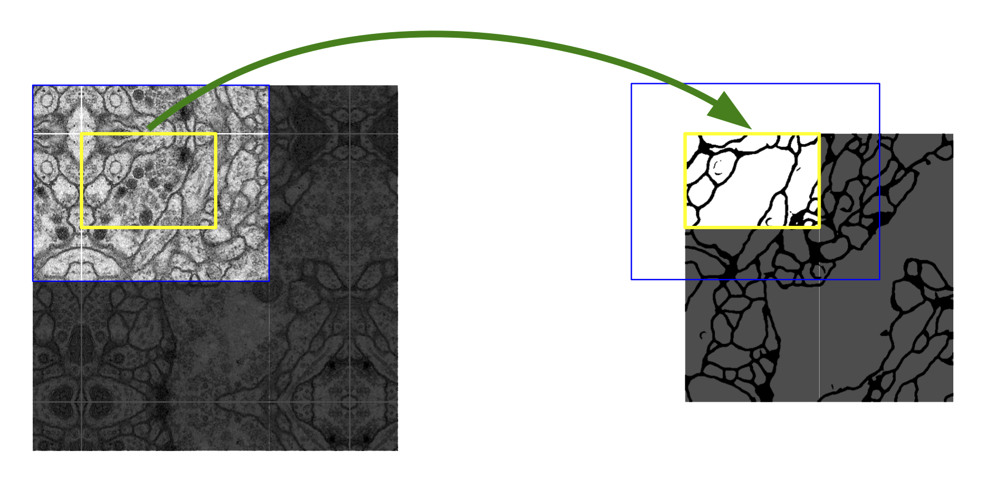
Image segmentation
U-Net (Ronneberger et al. 2015)
Segmenting biological cell membranes
Notes:
Done

Slide 43
Insights of U-Net
“Up-convolution”
Fixes the problem of shrinking images with CNNs
One example of how to make “fully convolutional” nets: pixels to pixels
“Up-convolution” is just upsampling, then convolution
Allows for refinement of the upsample by learned weights
Goes along with decreasing the number of feature channels
Not the same as “de-convolution”.
Connections across the “U” in the architecture

Slide 44
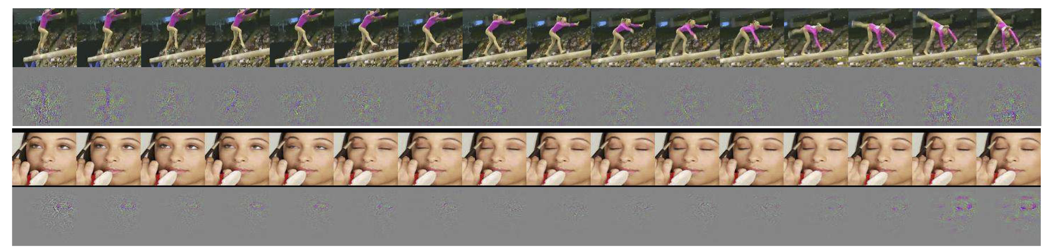
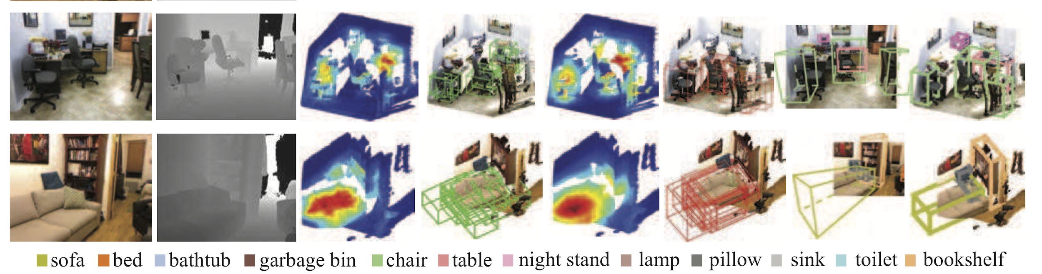
3D convolution
Motion in videos - Tran et al. (2015)
Objects from images w/ depths - Song & Xiao (2016)
Notes:
Done

Slide 45
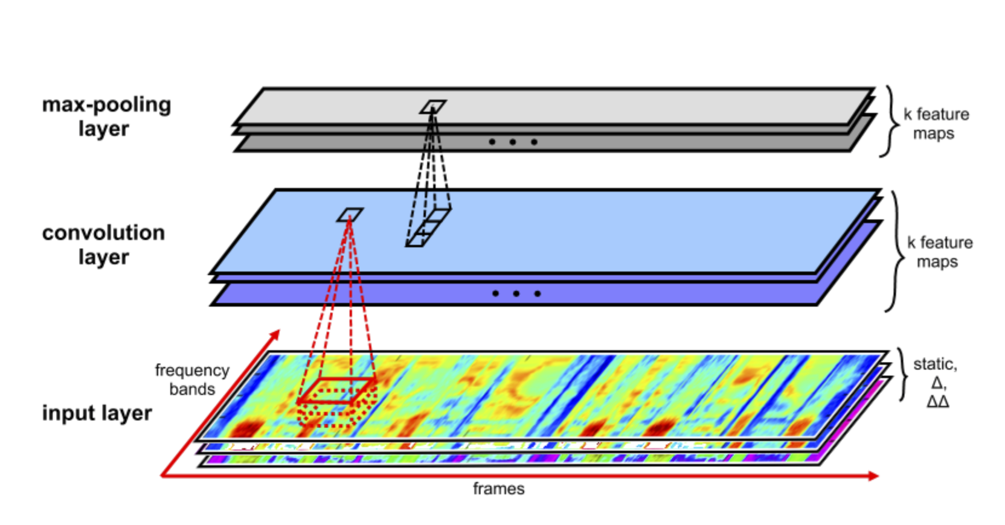
Speech recognition
Zhang et al. 2017
CNN competitive with RNNs (e.g. LSTMs)
10 layers, 3x5 conv, 3x1 pooling - deep enough for temporal dependencies
TIMIT task, classifying phonemes
Notes:
Done

Slide 46
Graph convolution
For a full intro: https://tkipf.github.io/graph-convolutional-networks/
Basic idea:
A convolution for matrices is a “local” combination of entries in the matrix
Can do the same thing for a graph
Here, “local” is whatever nodes a node is adjacent to
Just the tip of an iceberg…
Used in learning stuff about molecules, citations, social networks, etc.
Notes:
Done

Slide 47
Myth: CNNs are for computer vision, and RNNs are for NLP.

Slide 48
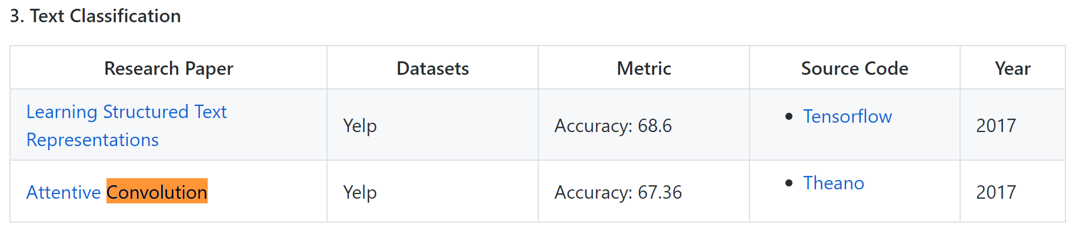
CNNs are SOTA in many NLP tasks
https://github.com/bentrevett/pytorch-sentiment-analysis/blob/master/4%20-%20Convolutional%20Sentiment%20Analysis.ipynb

Slide 49
Capsule Nets

Slide 50
Capsule networks agenda
Why convolutional neural networks and translational invariance suck.
Formulating a better prior.
The capsule architecture.
The dynamic routing algorithms

Slide 51
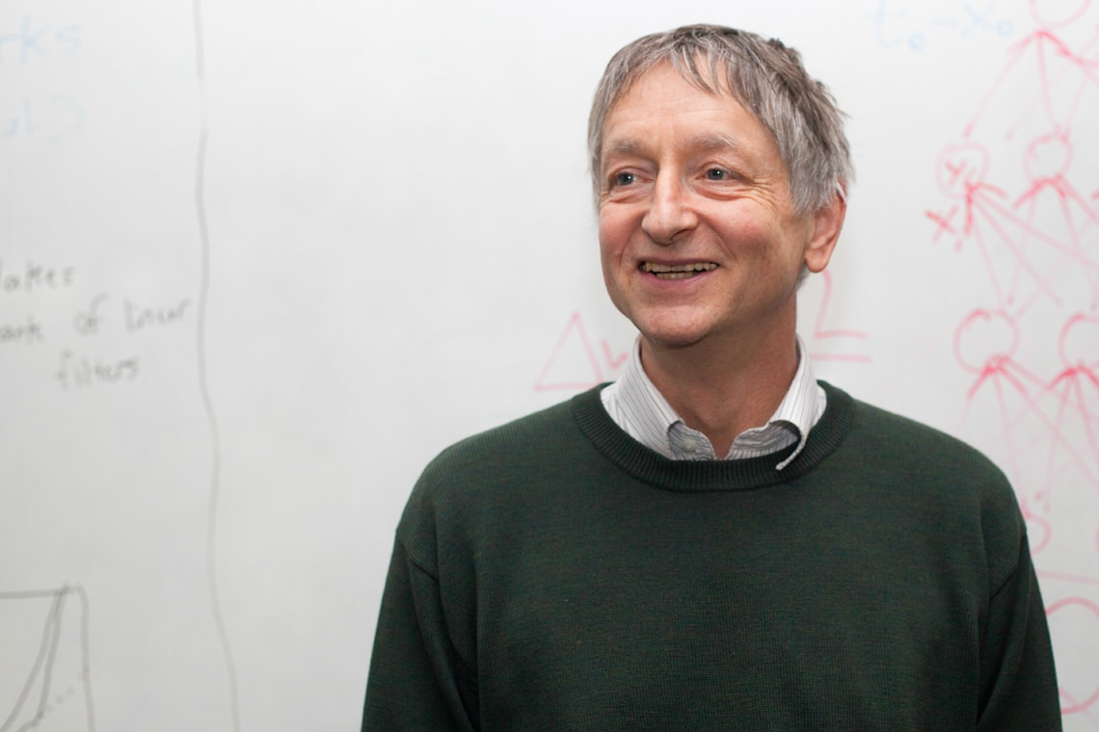
Geoffrey Hinton
English-Canadian cognitive psychologist and computer scientist
Popularized backpropagation
The "Godfather of Deep Learning"
Co-invented Boltzmann machines
Contributed to AlexNet
Advised Yann LeCunn, Ilya Sutskever, Radford Neal, Brendan Frey
Creator of capsule nets

Slide 52
Convolutional neural networks can be a mess.
Solves the wrong problem: we want equivariance, not invariance.
Bad fit to the psychology of shape perception.
Does not use underlying linear structure of the universe.
Fails to route information intelligently: max pooling sucks.

Slide 53
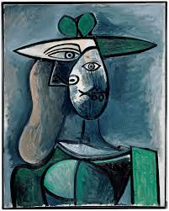
Translational invariance is the wrong problem
The Picasso problem: convolutional neural networks detect parts with no sense of a whole.
Notes:
Silicon valley reference

Slide 54
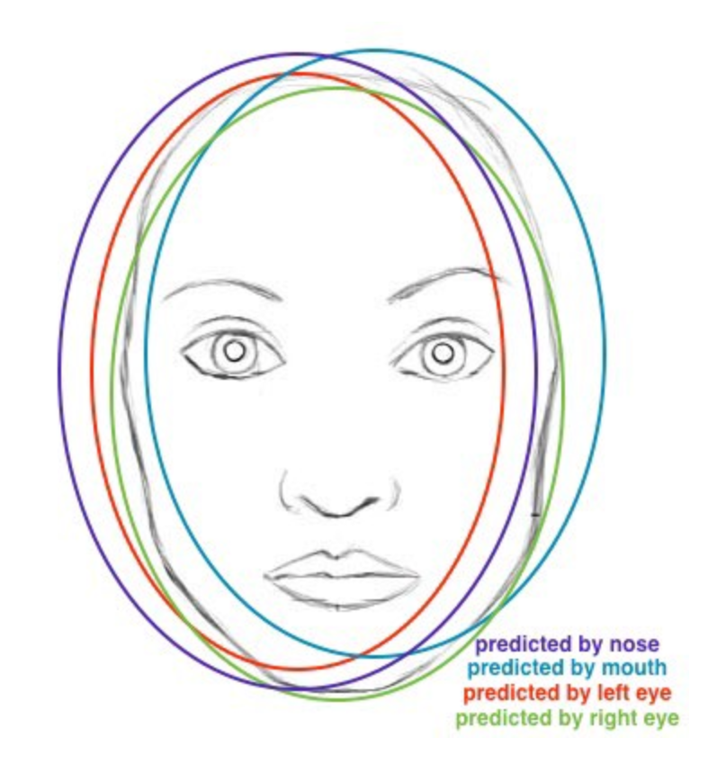
2, 3. Bad fit to human perception and structure of motion
https://youtu.be/rTawFwUvnLE?t=835
https://youtu.be/rTawFwUvnLE?t=1195

Slide 55
4. Pooling sucks
Does not account for the offset in its computation.
Ensure that information about localization is erased.
Certainly doesn't intelligently send information to the appropriate neurons.
E.g. if my data has (age, weight, sex) and my model has a neurons abstracting (sex, age, weight), there should ideally be a way to route the information to the right place.

Slide 56
“The pooling operation used in convolutional neural networks is a big mistake and the fact that it works so well is a disaster.”
-- Geoffrey Hinton

Slide 57
Given all these problems with CNNs, what might we hope for from a superior architecture?

Slide 58
Our wishlist for a new architecture
Awesome priors
Ontology: the world is made up of objects that have properties.
Inverse-graphics: objects move linearly in space (translation) and rotate.
Information is properly routed to the appropriate neurons.
Routes by "agreement" rather than by "volume."
Super interpretable
Clear representation of learned features
Visualization of internal representation
Learns with very few examples (fewer than 5 per class?)
Outperforms CNNs in accuracy
Runs blazingly fast

Slide 59
Our wishlist for a new architecture
Awesome priors
the world is made up of objects that have properties.
objects move linearly in space (translation) and rotate.
Information is properly routed to the appropriate neurons.
Routes by "agreement" rather than by "volume."
Super interpretable
Clear representation of learned features
Visualization of internal representation
Learns with very few examples (fewer than 5 per class?)
Outperforms CNNs in accuracy
Runs blazingly fast

